Slide 1


HOUSE PRICE PREDICTION
I N V RAO

Slide 2


Agenda
Data Preperation
Data Analysis
Data cleaning
Removing Outliers
Model Selection
Optimization
Saving & Loading the Model
Conclusion

Slide 3
Data Preperation
Checking the shape of Datasets
Checking the columns
Checking the Data types Of independent features
Checking the null values
Checking and dropping the unwanted columns
Checking Categorical columns and numerical columns

Slide 4
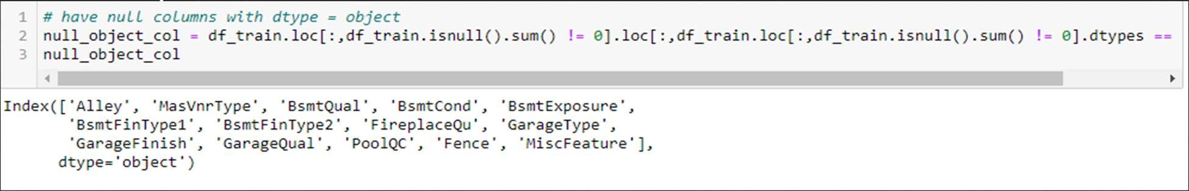
Most “Null” values actually mean “Not Available”
Example: PoolQC - Pool quality – Not Available means “No Pool”
Update all meaningful “Null_object col” to “Not Available”
For numerical columns like LotFrontage, GarageYrBlt, MasVnrArea, mean is used to replace the null values

Slide 5
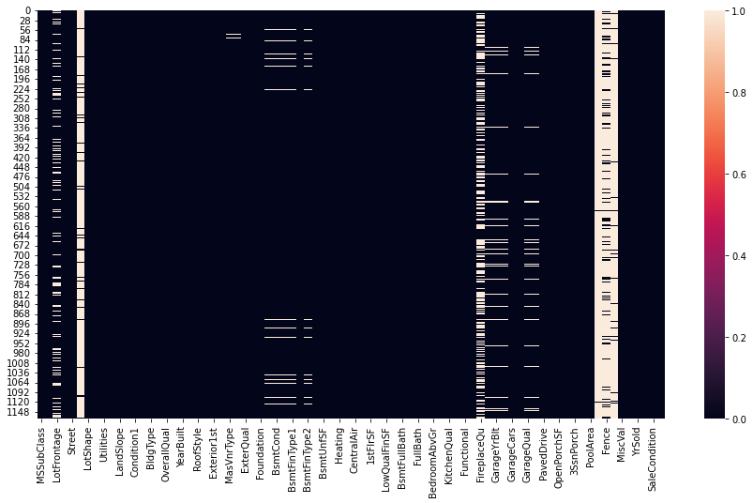
NULL/MISSING DATA HEAT MAP

Slide 6
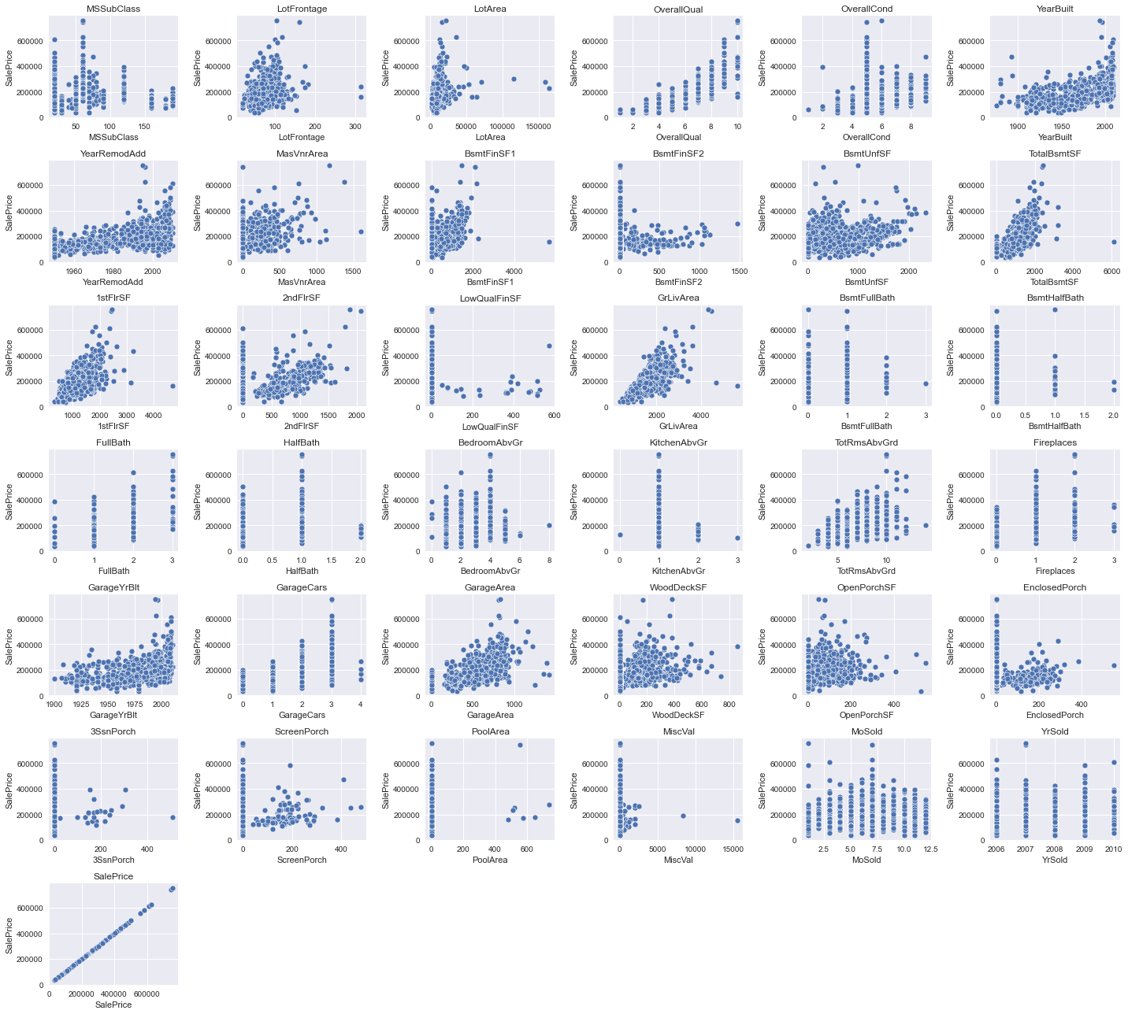
NUMERICAL FEATURES VS PRICE

Slide 7
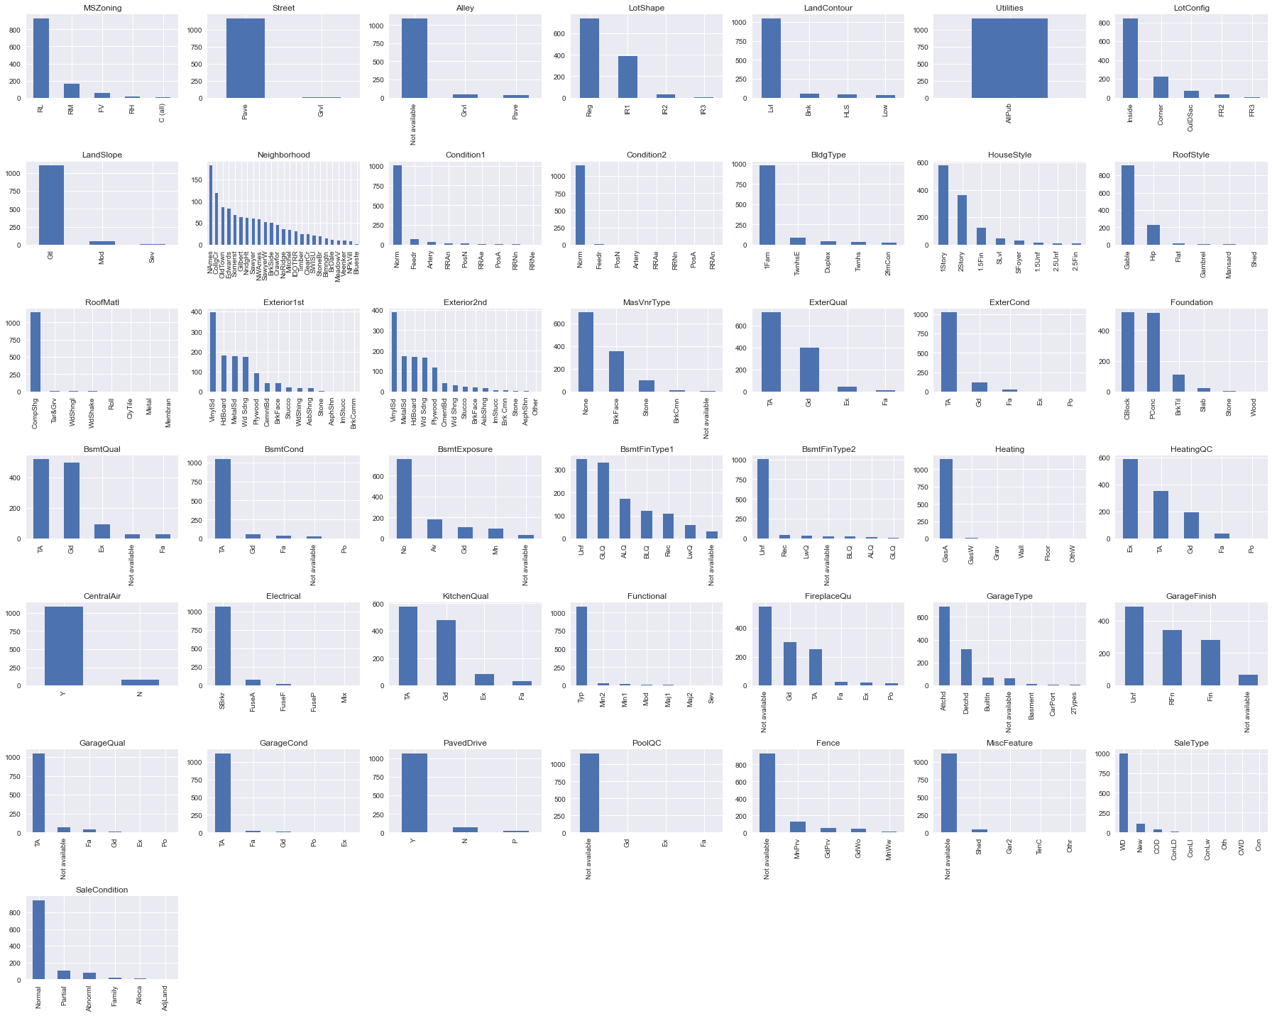
CATEGORICAL FEATURES UNIVARIATE ANALYSIS

Slide 8
OBSERVATIONS
Through bar charts of different categorical columns, we can see unique values and the value counts for categorical features
Here in all the numerical columns we can see through scatter plot that many numerical features are skewed on either the left side or right side. Also, there are so many outliers in the features.
Sale prices of houses were less in the past. But with time price increased.
With LotArea there is increase in Price, but there may be outliers
With OverallQual, OverallCond, YearBuilt, YearReMOdAdd,MassVnrArea,GrLivArea there is increase in Price, but there may be outliers
With TotRmsAbvGrd, GarageArea, FullBath,2ndFlrSF,1stFlrSF, TotalBsmtSF,BsmtUnfSF, BsmtFinSF1,MasVnrArea increase, prices increasing
The more is the Ground living area, the more is the sale price.
The more is the garage area, the more is the sale price

Slide 9
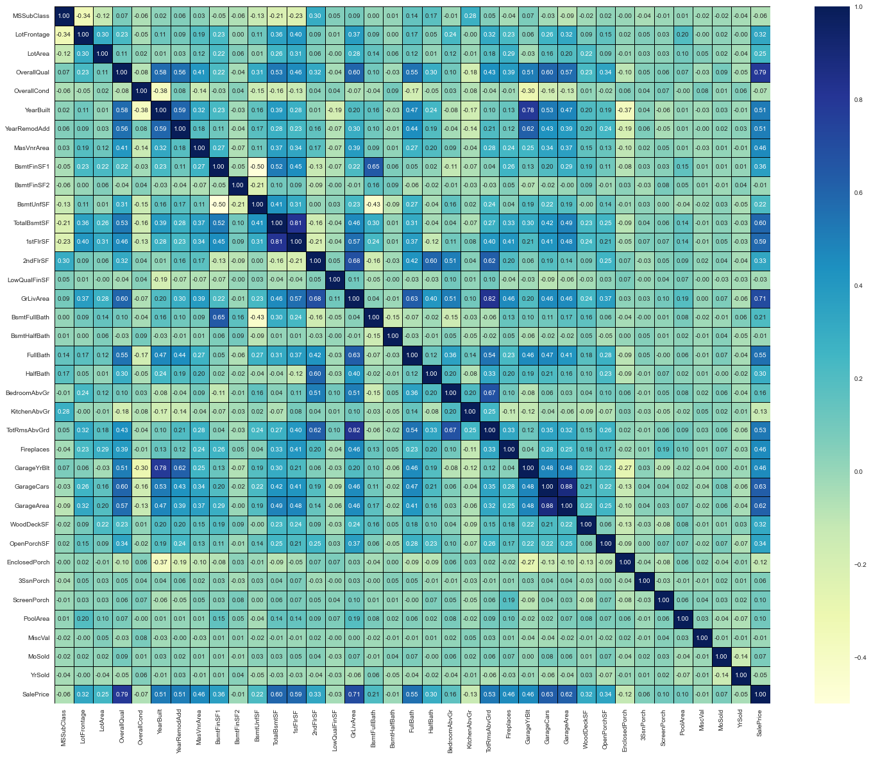
CORRELATION

Slide 10
CORREALTION OBSERVATIONS
From the above heatmap we can clearly see that OverallQual,,YearBuilt,YearREmodAdd,TotalBsmtSF,1stFlrSF,GrLivARea,FullBath,TotRmsAbvGrd,FirePlaces,
GarageyrBilt,GarageCars,GarageARea are highly positive correlated with the SalePrice
TOP 10 Correlated with selling price:
'OverallQual', 'GrLivArea', 'GarageCars', 'GarageArea', 'TotalBsmtSF', '1stFlrSF', 'FullBath', 'TotRmsAbvGrd', 'YearBuilt'

Slide 11
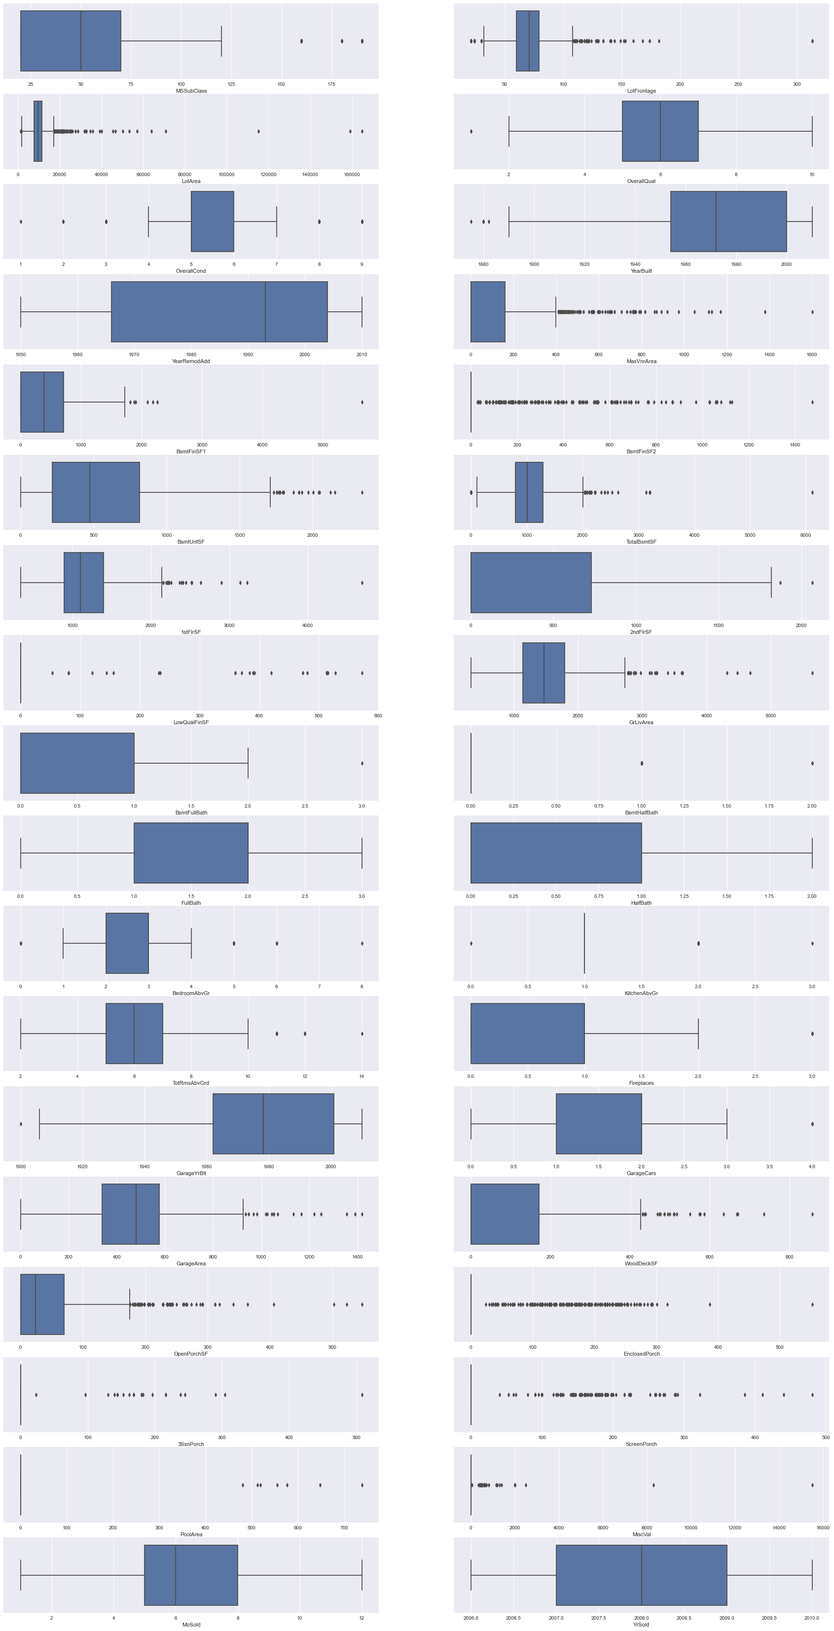
OUTLIER DETECTION

Slide 12
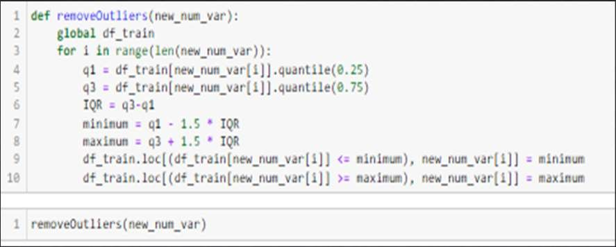
So many outliers are there in all the features. We removed the outliers using the interquartile method.

Slide 13
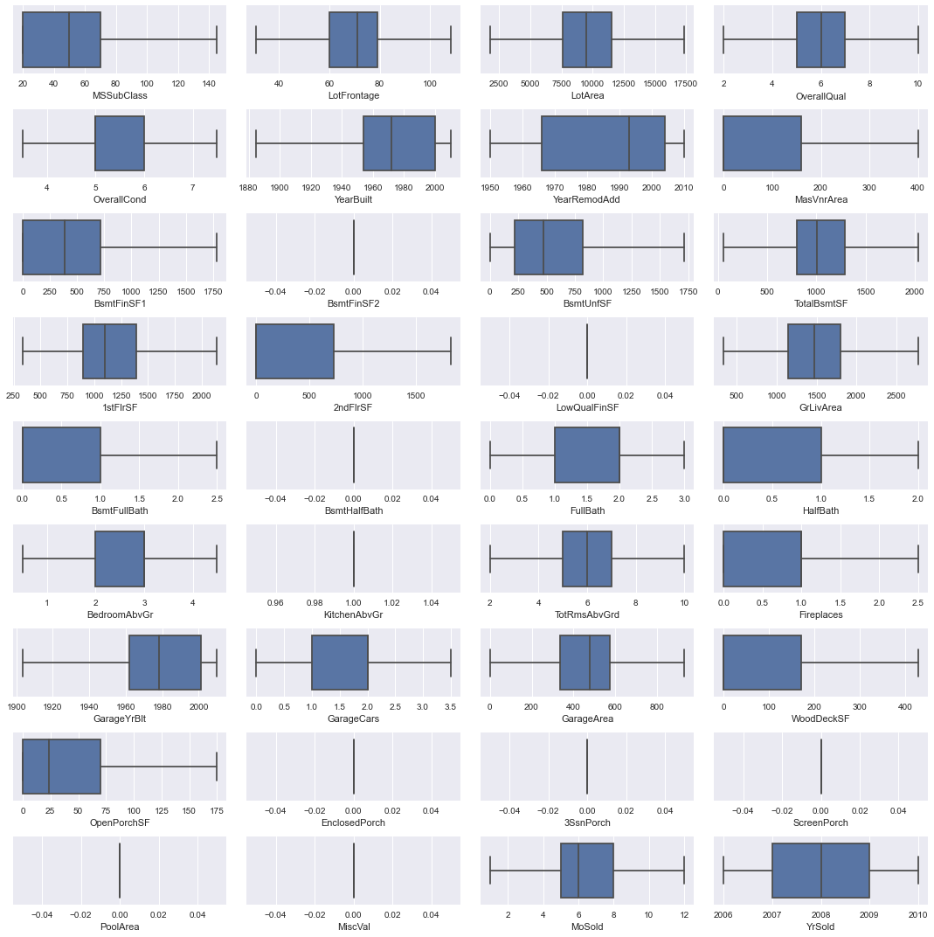
AFTER OUTLIER REMOVAL

Slide 14
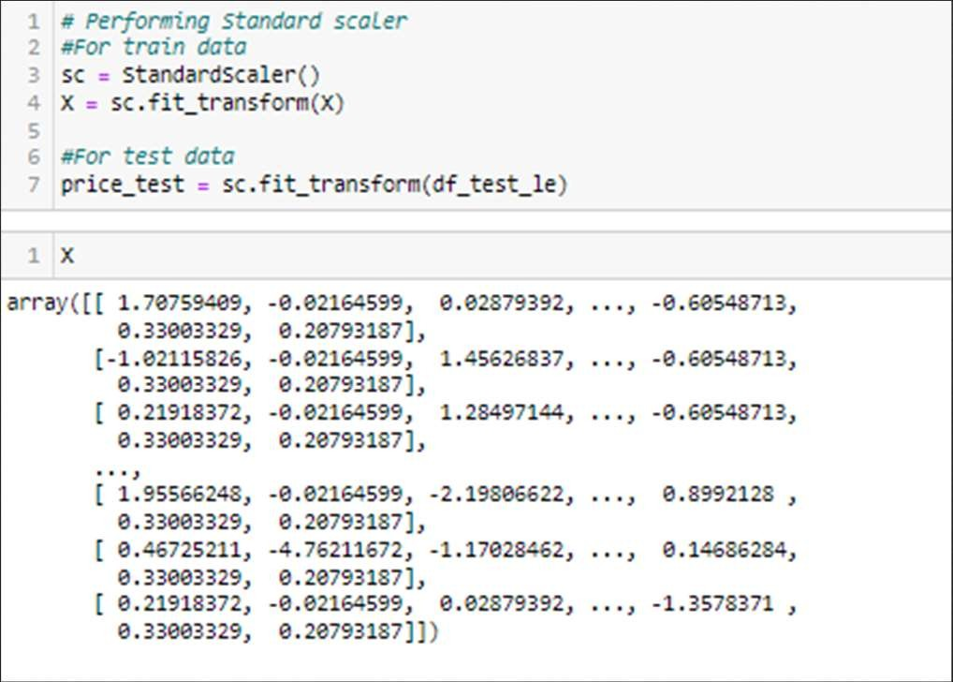
Label Encoding & Feature Engineering
Converted all the categorical columns to numerical columns using By using a standard scaler, I have scaled the data in one range.

Slide 15
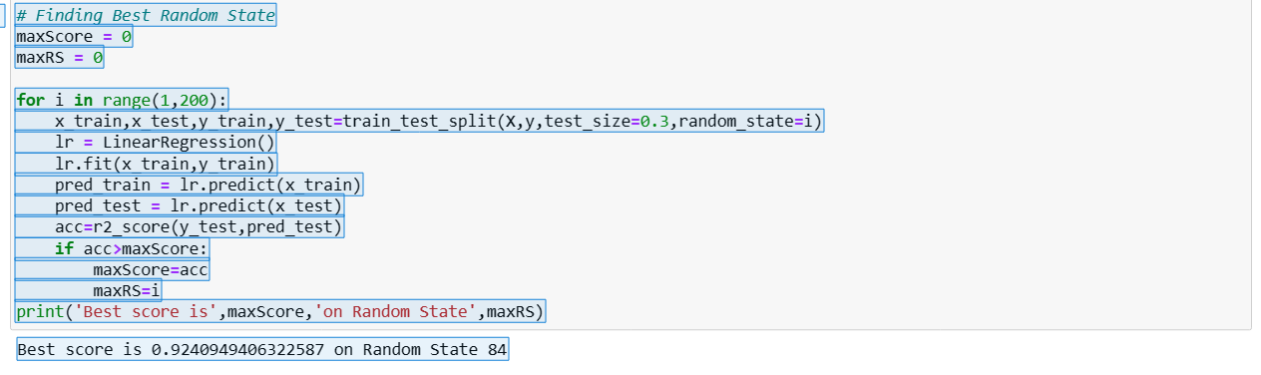
Checking for best random state

Slide 16
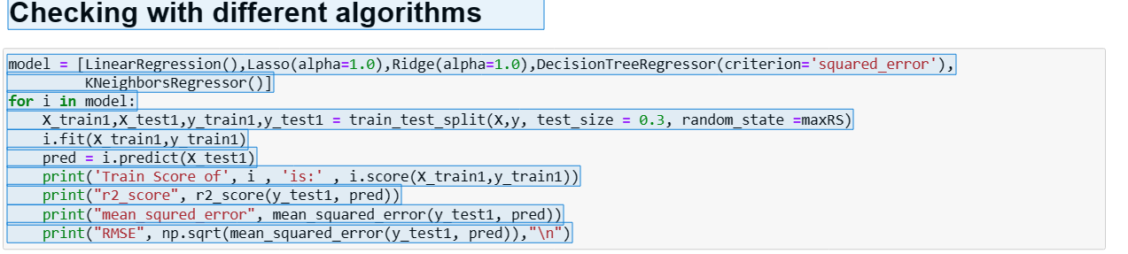
Checking with Different Algorithms
Applying different algorithms
LinearRegression(),
Lasso()
Ridge()
DecisionTreeRegressor()
KNeighborsRegressor()]

Slide 17
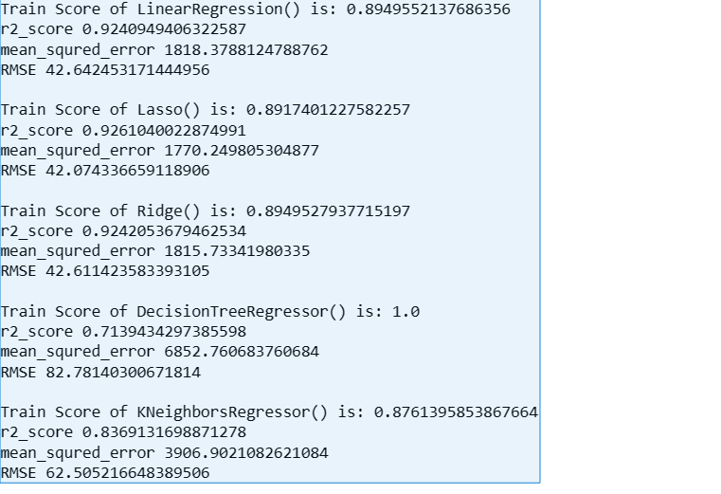
Train & Test Score of the Algorithms
The Decision tree regressor model is overfitting. Other models are working well. But lasso regression is having less train and test score difference with least mean square error and least RMSE.

Slide 18
Ensemble Technique for Boosting performance
RandomForestRegressor
Train Score of RandomForestRegressor(random_state=84) is: 0.9813767323691924
r2_score 0.8930452761631832
mean_squred_error 2562.203433333333
RMSE 50.61821246679236
AdaBoost Regressor
Train Score of AdaBoostRegressor(base_estimator=Lasso(), random_state=84) is: 0.8622186362608182
r2_score 0.8681156446260295
mean_squred_error 3159.4167701999245
RMSE 56.20868945456676

Slide 19
Ensemble Technique for Boosting performance
RandomForestRegressor
Train Score of GradientBoostingRegressor() is: 0.9679385176546844
r2_score 0.9175740653553743
mean_squred_error 1974.592660950527
RMSE 44.436388927888
Out of these Three, Gradient boost regressor is having the low MSE, RMSE and high Train SCore, But the difference between the test and train scores are high So we are selecting the AdaBoost as the difference between the test train scores are low

Slide 20
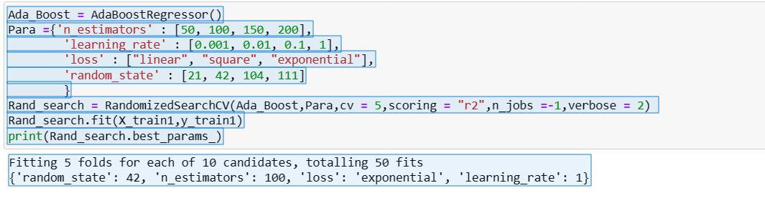
Hyper Parameter Tuning
prediction = Rand_search.predict(X_test1)
SalePrice = AdaBoostRegressor(n_estimators= 200, loss= 'linear', learning_rate =1, random_state=21)
SalePrice.fit(x_train, y_train)
pred = SalePrice.predict(x_test)
print('R2_Score:',r2_score(y_test,pred)*100)
print("RMSE value:",np.sqrt(mean_squared_error(y_test, pred)))
R2_Score: 86.10867102218688
RMSE value: 56.92657392948996

Slide 21
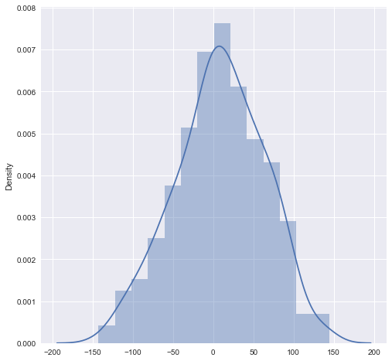
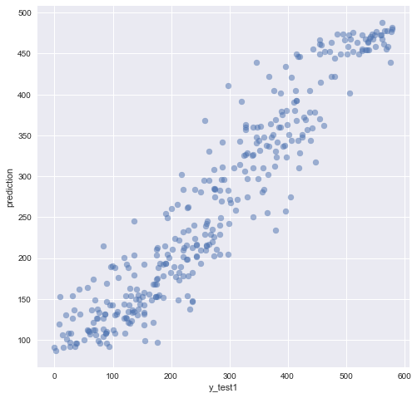
Residual Plotting//Actual vs Predicted

Slide 22
Conclusions
We have done a complete EDA process, getting data insights, feature engineering, and data visualization as well so after all these steps one can go for the prediction using machine learning model-making steps.
We have training and test file separately available with us. we have both numerical and categorical data types features in both datasets and the dependent variable of train data i.e. the price is the numerical data type. So, I applied the regression method for prediction.
Once data has been cleaned for both test and train datasets, Label encoding is applied to them to convert them into Numerical ones. I trained the model on five different algorithms but for most of the models, train and test data was having a high variance, and the model was overfitting.
Only Ada Boost regressor worked well out of all the models, as there was less difference between train score and test score and RMSE was also low hence I used it as the final model and have done further processing.
After applying hyperparameter tuning I got an accuracy(r2_score) of 86% from the Ada Boost Regressor model which is a good score. Then I applied that score to the test dataset to get the target variable which is price.

